Slide 1
Customer Retention & Churn Analysis
Power bi project
SANDRA A

Slide 2
introduction
The aim of this project is to analyze customer data to identify key factors influencing customer churn and provide insights that can help improve customer retention and business performance.
Notes:
Goal: Identify the main drivers of customer churn.
Aim: Provide actionable insights to improve retention strategies.
Purpose: Help the business reduce churn, increase loyalty, and improve profitability.

Slide 3
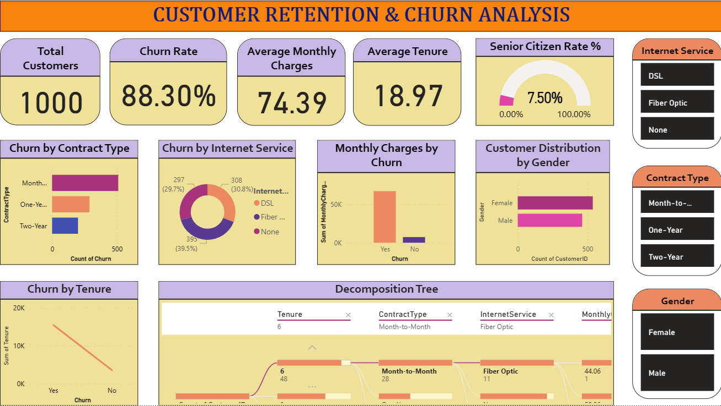
Dashboard overview

Slide 4
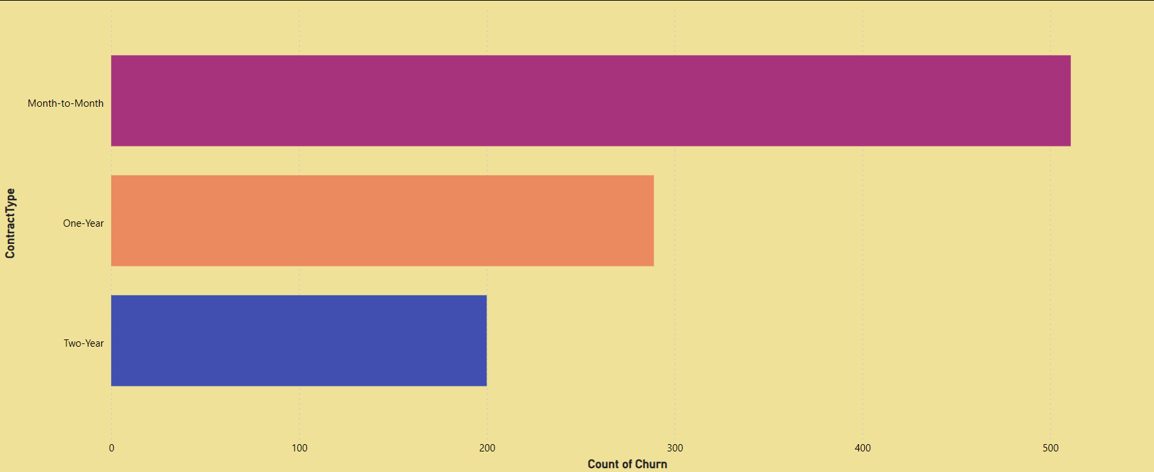
analysis
CHURN BY CONTRACT TYPE
Finding: Month-to-Month contracts have highest churn
Insight: Long-term contracts reduce churn
Suggestion: Promote annual contracts with incentives
Notes:
Customers without long term commitment are more likely to leave
Artificial Retention: Termination Fees -> Higher revenue predictability

Slide 5
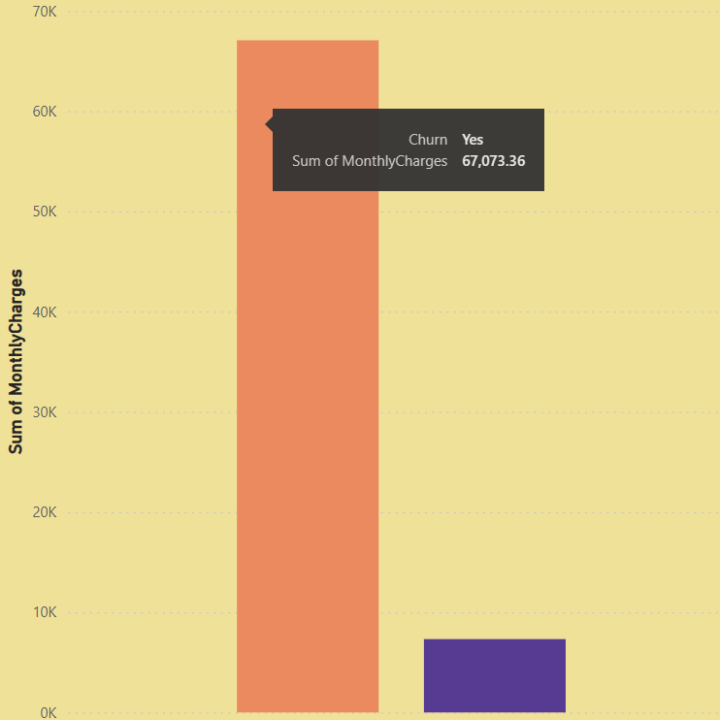
Monthly Charges by Churn
Finding: Churned customers have higher monthly charges
Insight: Price sensitivity is a churn driver
Suggestion: Offer discounts or value-added services to high-charge customers
Notes:
Price sensitive customers leave more

Slide 6
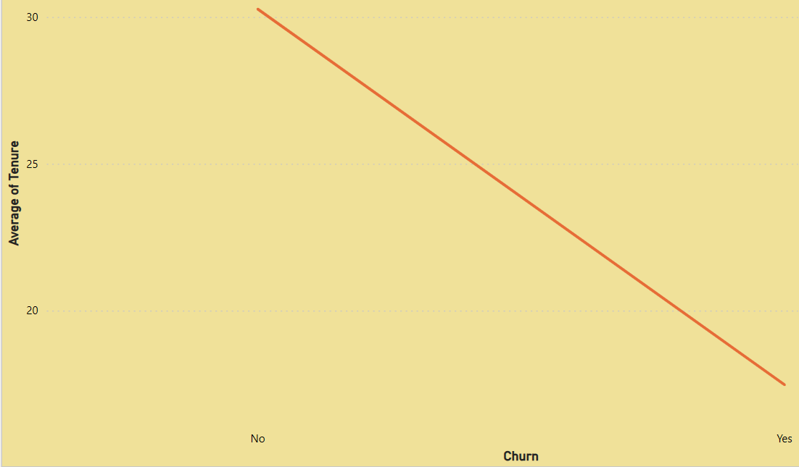
Churn by Tenure
Finding: Churn is highest among customers with shorter tenure
Insight: Early-stage retention is critical
Suggestion: Strengthen onboarding and first-year engagement
Notes:
New customers churn more early stage experience is critical

Slide 7
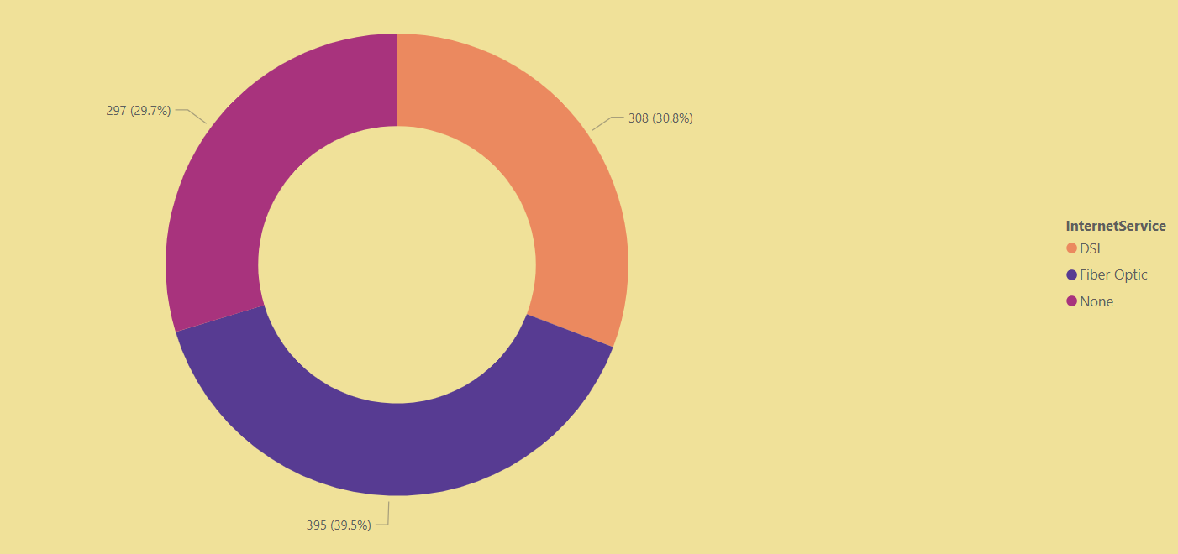
Churn by Internet Service
Finding: Fiber Optic customers churn most (39.5%)
Insight: Service quality or pricing issues in Fiber Optic
Suggestion: Improve Fiber Optic service reliability or pricing

Slide 8

Customer Distribution by Gender
Finding: Balanced distribution between male and female
Insight: Gender is not a major churn driver
Suggestion: Focus retention strategies on service type, not demographics
Notes:
Relatively balanced
Demographic compositions

Slide 9
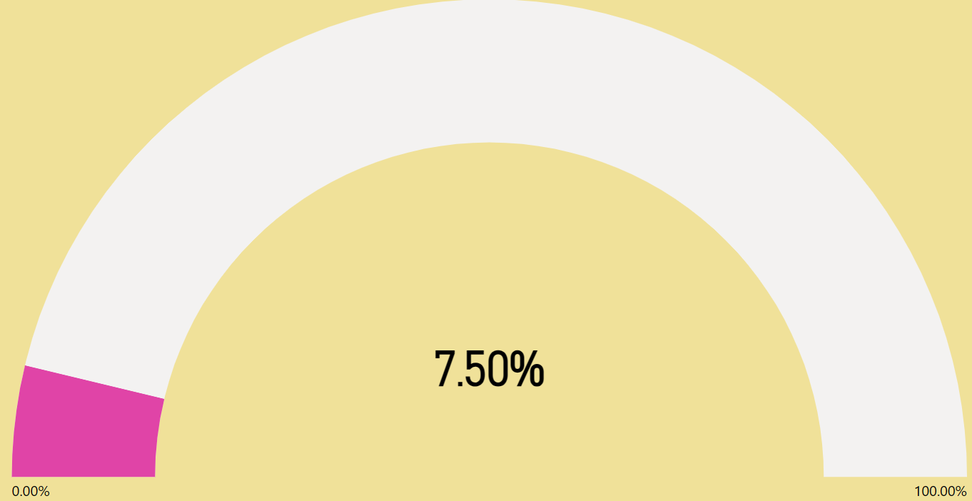
Customer Distribution by Senior citizen rate%
Finding: Senior citizens make up 7.5% of customers
Insight: A small but distinct segment
Suggestion: Tailor communication/support for seniors, but focus retention on broader churn drivers
Notes:
Tailored services

Slide 10
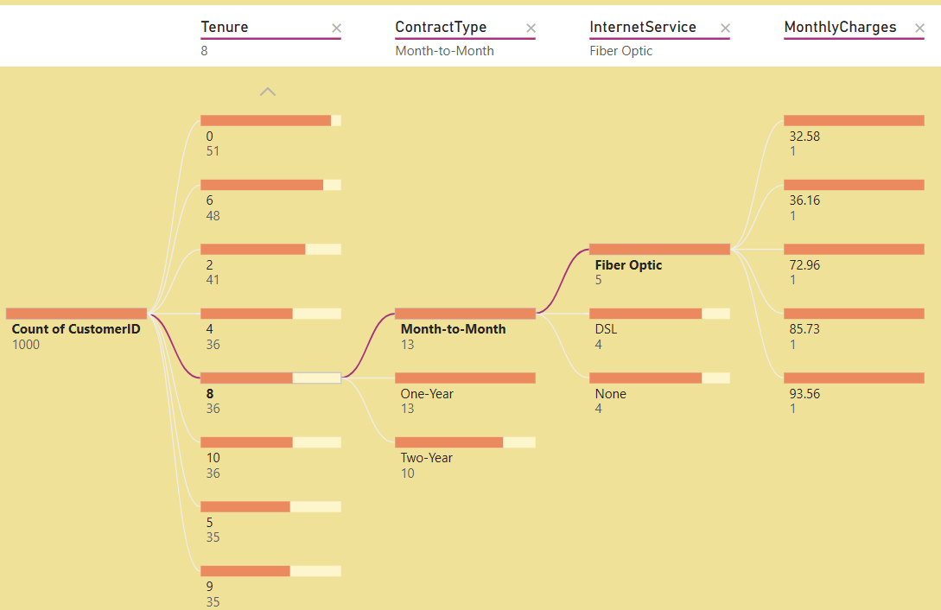
Decomposition Tree
Finding:
Fiber Optic customers consistently show higher churn rates
Service + Month-to-Month + low tenure drives churn
Insight: Service type, Contract type and tenure are key churn predictors
Suggestion:
Conduct customer feedback surveys specifically for Fiber Optic users
Target short-tenure, month-to-month customers with retention offers

Slide 11
findings
Churn is critically high (88.3%), driven by Month-to-Month contracts and Fiber Optic service customers
Price sensitivity is evident — churned customers pay higher monthly charges
Tenure matters — customers with shorter tenure churn more, highlighting weak early retention. But Fiber Optic churn remains high across all tenures
Demographic compositions are not significant churn drivers, but contract type and service quality are decisive

Slide 12
SUGGESTIONS
Contract Strategy: Incentivize long-term contracts to reduce churn
Pricing Strategy: Introduce loyalty discounts or bundles for high-charge customers
Service Quality: Improve Fiber Optic reliability and customer support
Retention Programs: Focus on onboarding and first-year engagement to extend tenure

Slide 13
conclusion
The analysis shows that Fiber Optic customers, especially on month‑to‑month contracts and with shorter tenure, churn at the highest rates. Combined with price sensitivity among high‑charge customers, this highlights that service quality, contract structure, and early engagement are the key levers for retention. Addressing these areas will reduce churn, strengthen customer loyalty, and improve overall business performance
Notes:
To reduce churn, the business must improve Fiber Optic service reliability, incentivize long-term contracts, and strengthen early engagement programs. These actions will directly address the root causes of churn and improve overall customer loyalty.

Slide 14


